Slide 1
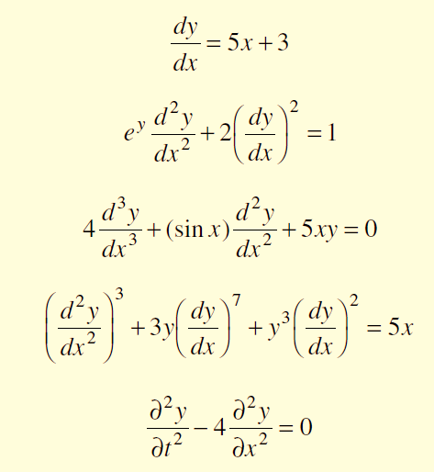

Differential equation
Definition. An equation involving derivatives or differentials of one or more dependent
variables with respect to one or more independent variables is called a differential equation.
A differential equation is an ordinary
differential equation if the unknown function depends on only one independent variable.
( A differential equation involving derivatives with respect to a single independent variable is called an ordinary differential equation.)
If the unknown function depends on two or more independent variables, the differential equation is a partial differential equation.
(A differential equation involving partial derivatives with respect to more than one
independent variables is called a partial differential equation.)
ODE
PDE

Slide 2

The order of a differential equation
1)The order of a differential equation
is the order of the highest derivative appearing in the equation.
2)The order of the highest order derivative involved in a differential equation is called the order of the differential equation.
Is the 4th order differential equation.

Slide 3
The Degree of a differential equation
The degree of a differential equation is the degree of the highest derivative which occurs in it, after the differential equation has been made free from radicals and fractions as far as the derivatives are concerned.
Order = 1 ,degree = 1
Order = 2 ,degree = 1
Order = 3,degree = 1
Order = 2 ,degree = 3

Slide 4
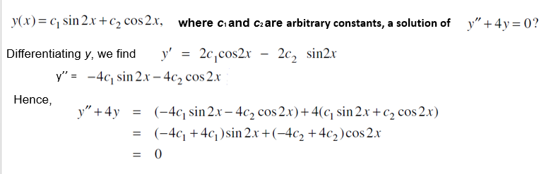
Solution of a differential equation
Any relation between the dependent and independent variables, when substituted in the differential equation, reduces it to an identity is called a solution or integral of the differential equation.

Slide 5
Solutions of First-Order Differential Equations
✔ Separable Equations
✔ Homogeneous Equations
✔ Exact Equations
✔ Linear Equations
✔ Bernoulli Equations
✔ Solved Problems

Slide 6
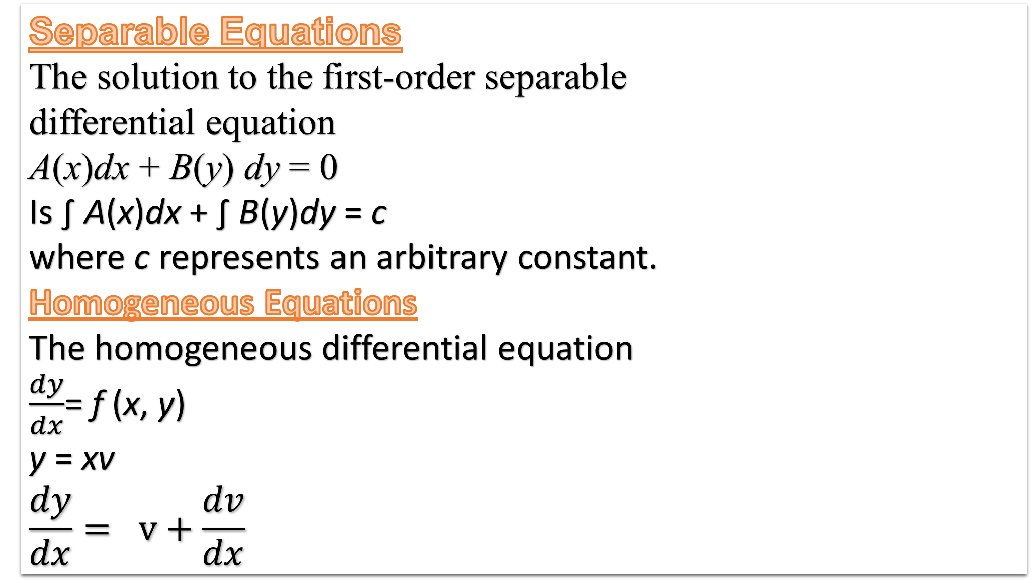

Slide 7
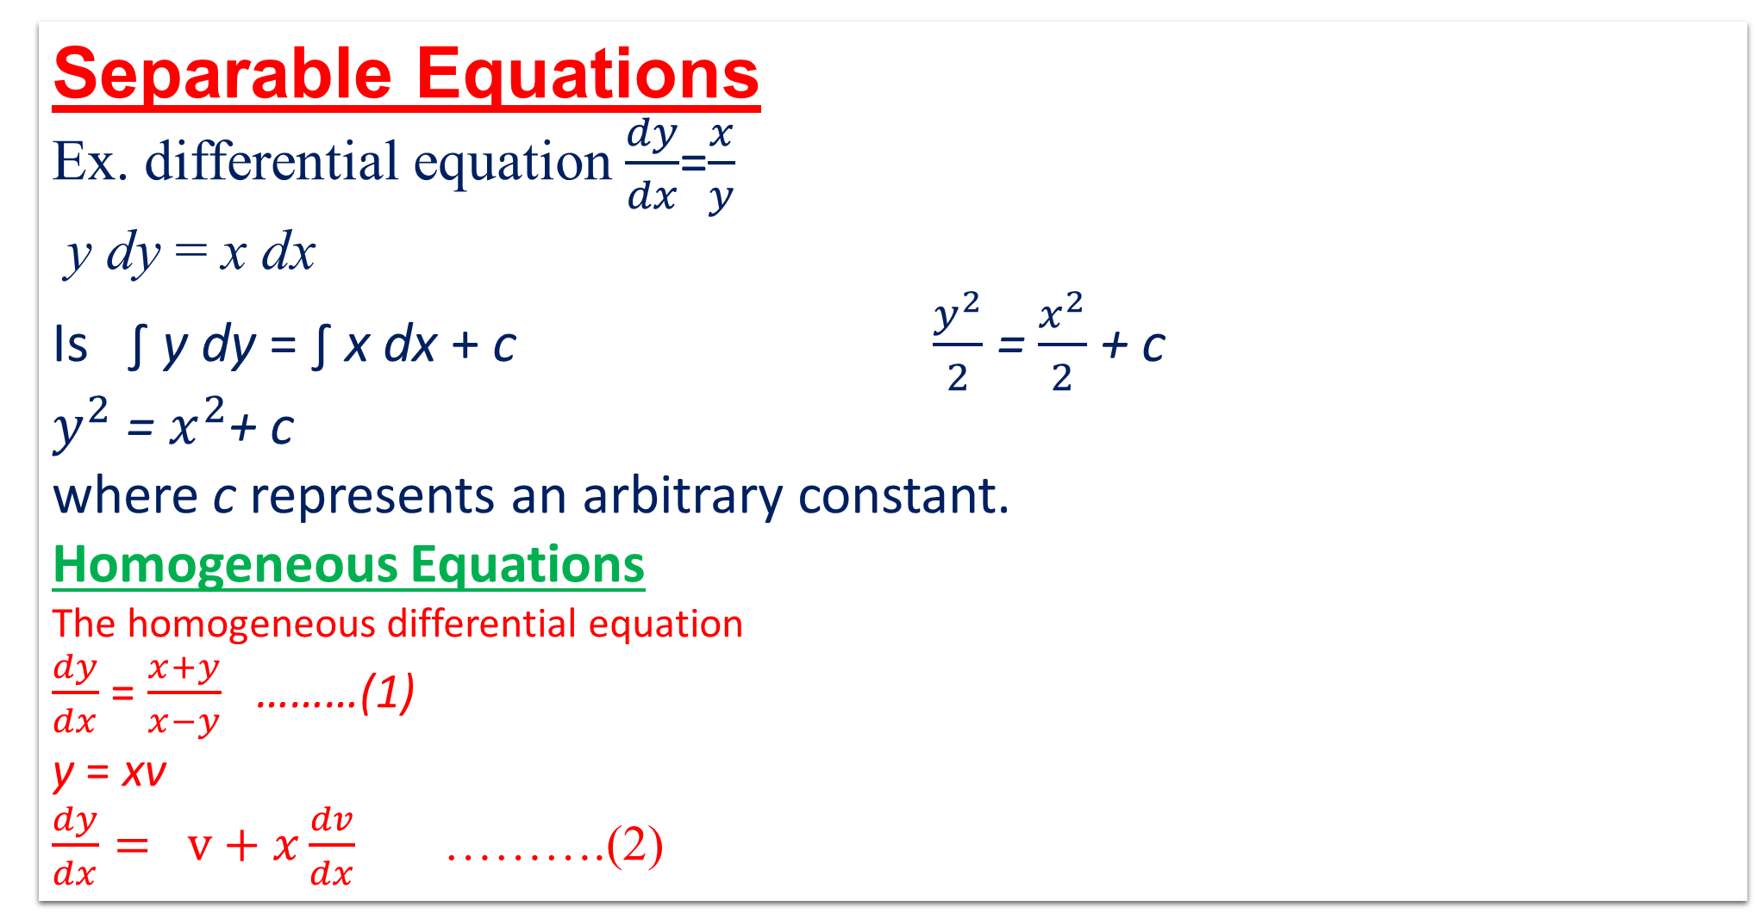

Slide 8
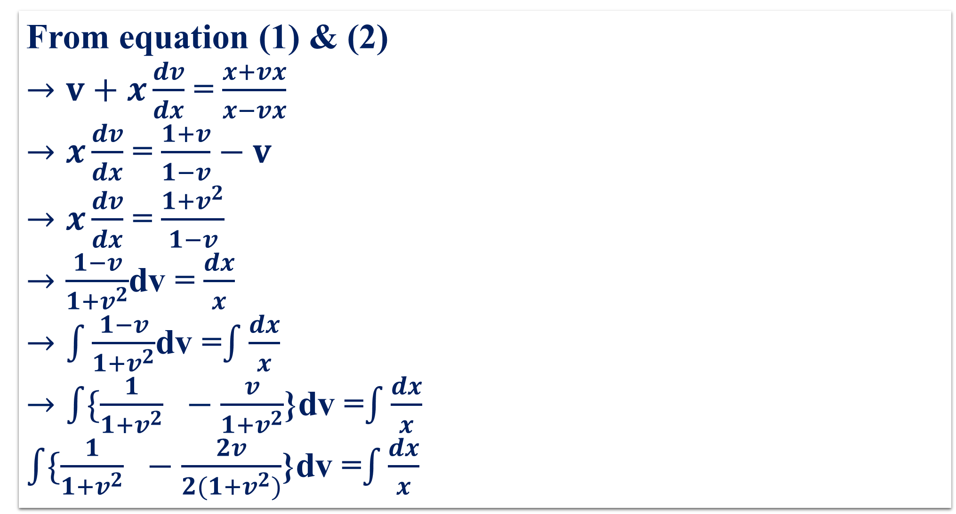
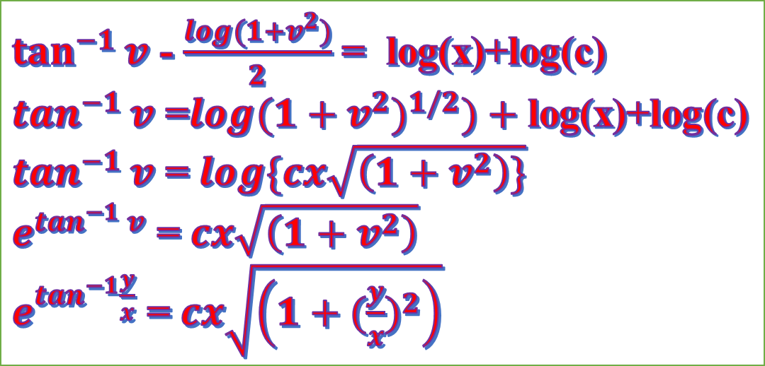

Slide 9
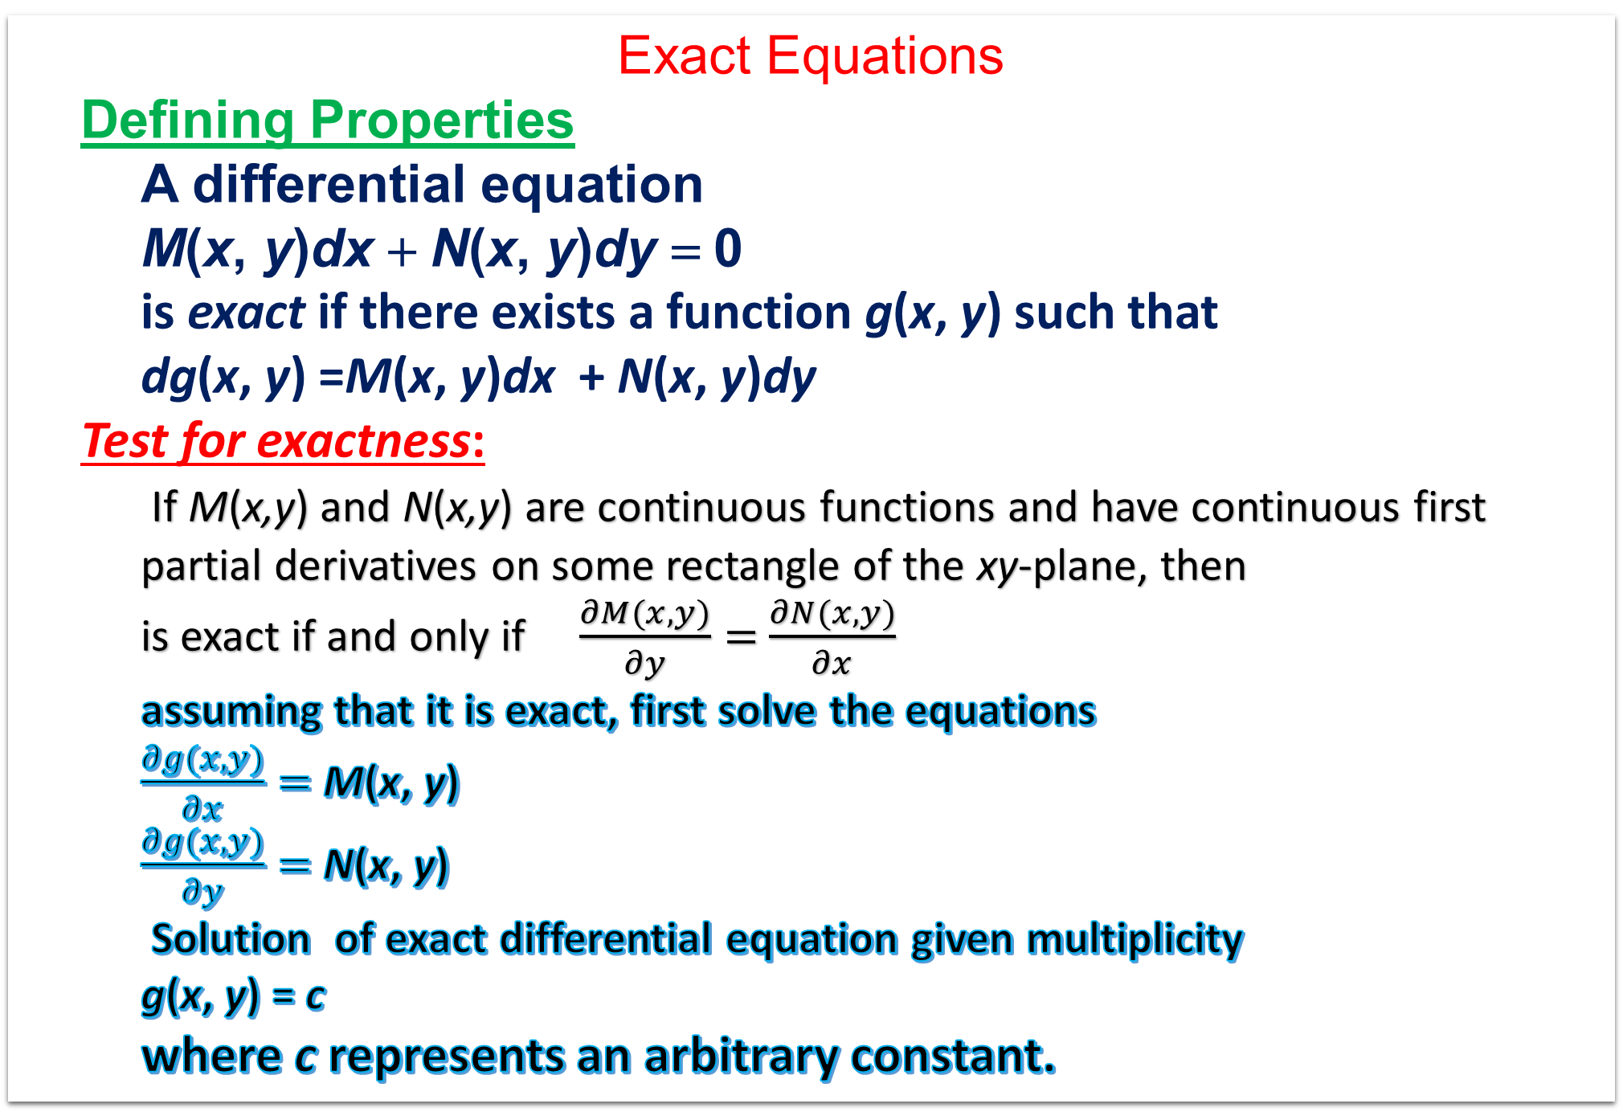

Slide 10
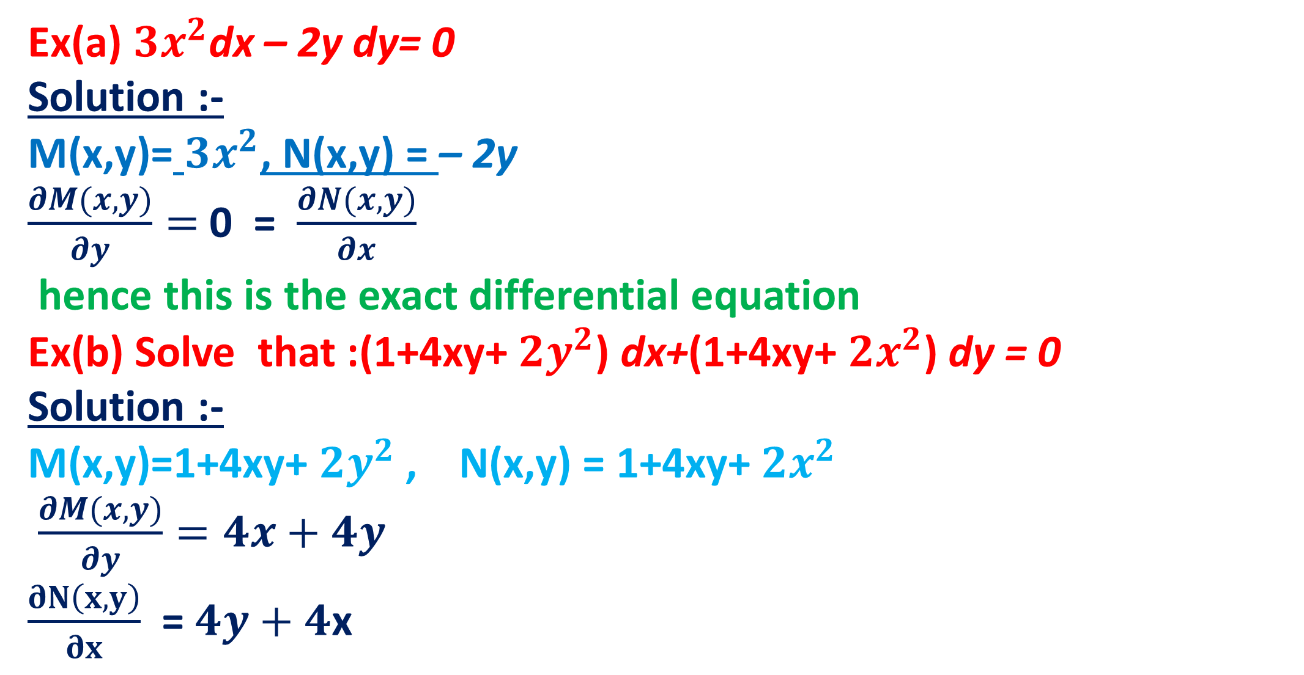

Slide 11
